Slide 1

#InfosysHackathon Parking Management Solution
Bhubaneswar DC
Team: Warriors
Shiv_Mishra; Bhuban_Mishra; Ramu_Alagappan
Notes:
Hello All, During the Infosys Hackathon, we have been working on a low cost parking solution. We are Team Warriors from Bhubaneswar DC. I am Bhuban and my other team members are Shiv and Ramu.

Slide 2
Problem Statement
Notes:
The Problem Statement that we are trying to address is, Whenever an Infoscion starts from Home to Office, the first thought that comes to our mind is “Will I get a parking near my building”? After entering the campus, we visit to different parking spaces in search of a free slot, and in the process loose a lot of time. It would be a life saver, if we meet a “Friend” near the gate, who could guide us to the nearest free parking space, and hence we will save precious time and thoughts for other productive work.

Slide 3
Solution Approach
Notes:
The main principle behind the solution is low cost and reuse. Hence we are basing our solution on Image Processing. We will be processing the images from the security camera feeds to derive the number of parking slots available at a particular parking area.

Slide 4
Video Feed
Image Processor
File Store
Services
Database
Dashboard
&
Admin Console
Notes:
Here is a high level architecture of the solution. The Video Feed capture images at pre-determined intervals from a Camera and saves it to a File System. The Image Processor continuously monitors the file system for changes. On detecting a change, it processes the image to derive the available parking slots, and calls a Service to update information to the database. There are admin and User dashboards that fetches information from the database through services and provides necessary information to the end users.

Slide 5
Components
Notes:
The various components involved are as follows:

Slide 6
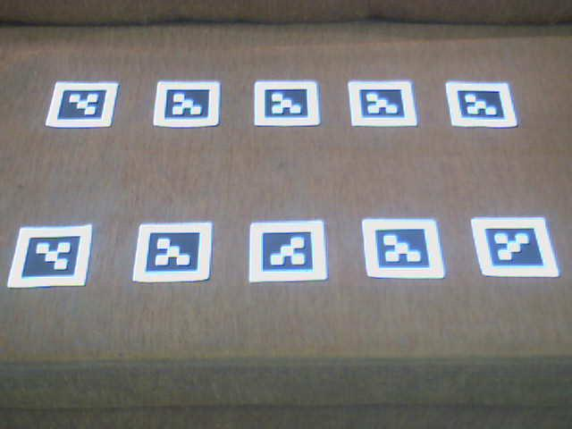
Notes:
This is a parking area. We have assumed that the parking slots will be painted with a unique Glyph image. The presence of a glyph will mean availability of a parking slot.

Slide 7
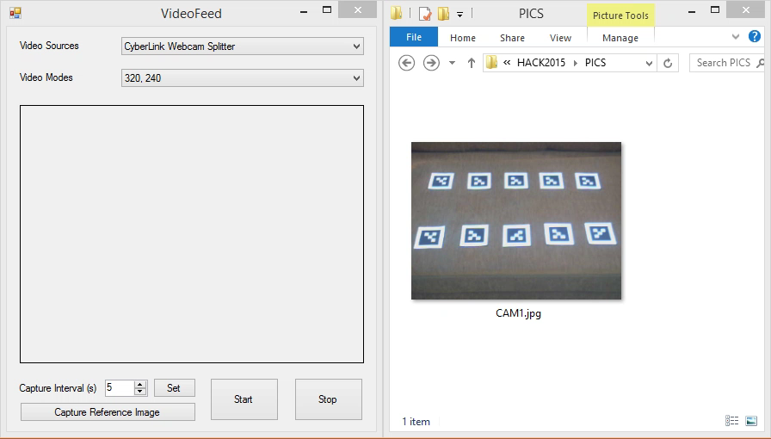
Notes:
This is simulation of the Video Feed module. For the purpose of this demo we have connected a WebCam to the system to get the image feed. In real time, we have assumed that we will be getting the RTMP feed from the Security Cameras. On Setting the capture interval, frames are captured and saved as jpeg images to a folder.

Slide 8
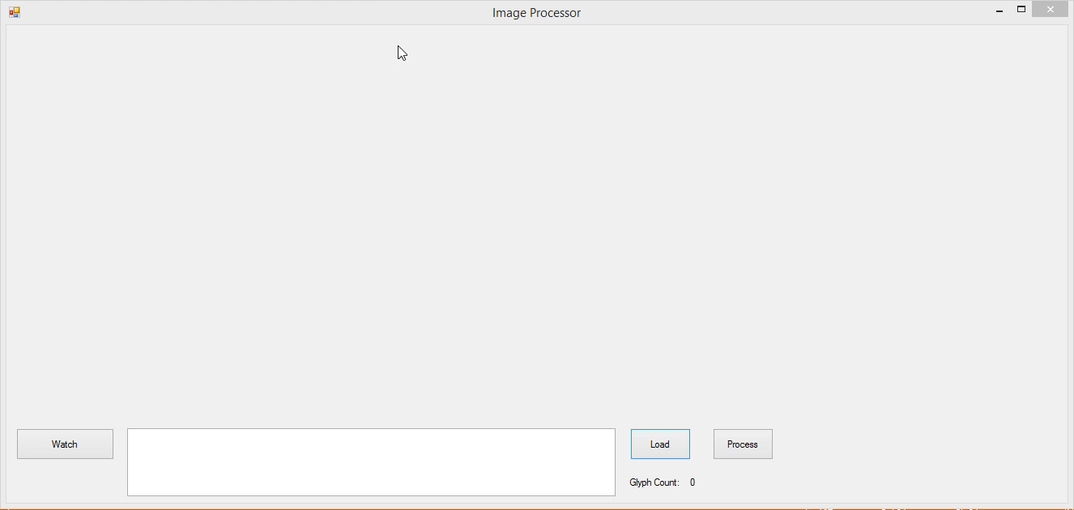
Notes:
The Image processor watches for changes to saved images, transforms them through Greyscaling, Binerization and Blob Counting through Edge Detection. We are using Aforge.NET, an open source library for processing the images. In short it detects the Glyph Images to determine the available Parking Slots. It then calls a Service that updates data in the database.

Slide 9
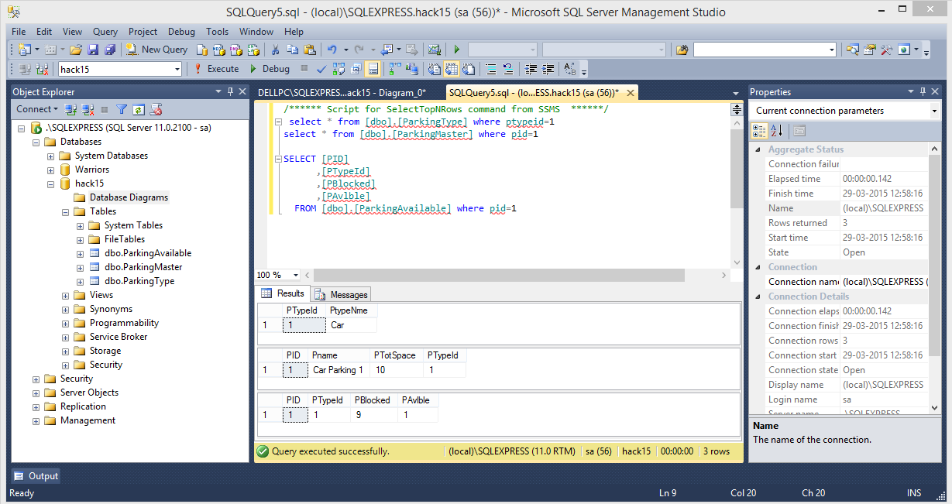
Notes:
Here is the database that is updated after capturing and processing the image. We are maintaining the data regarding the type of parking, the total number of slots available per area and the total number of free slots available. The data manipulation is handled through REST based services.

Slide 10
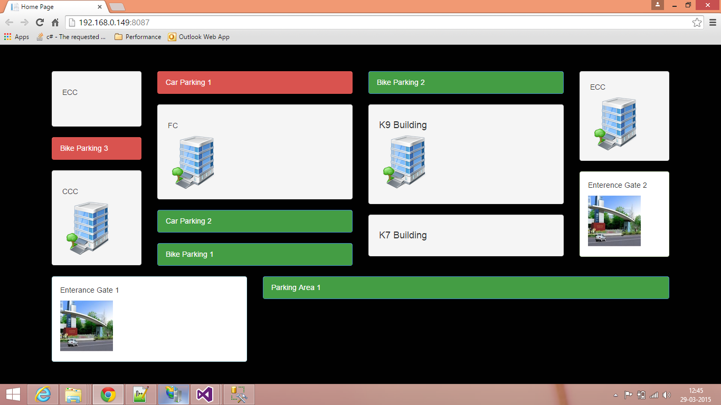
Notes:
This is the User Dashboard, a map of Bhubaneswar DC with the parking information on a screen, that is available near the gates. This will help commuters to find out the nearest parking space available near their building. Different views could be made available near each gate so that it would be more intuitive for users.

Slide 11
The Setup
Notes:
Lets have a look at the setup.

Slide 12
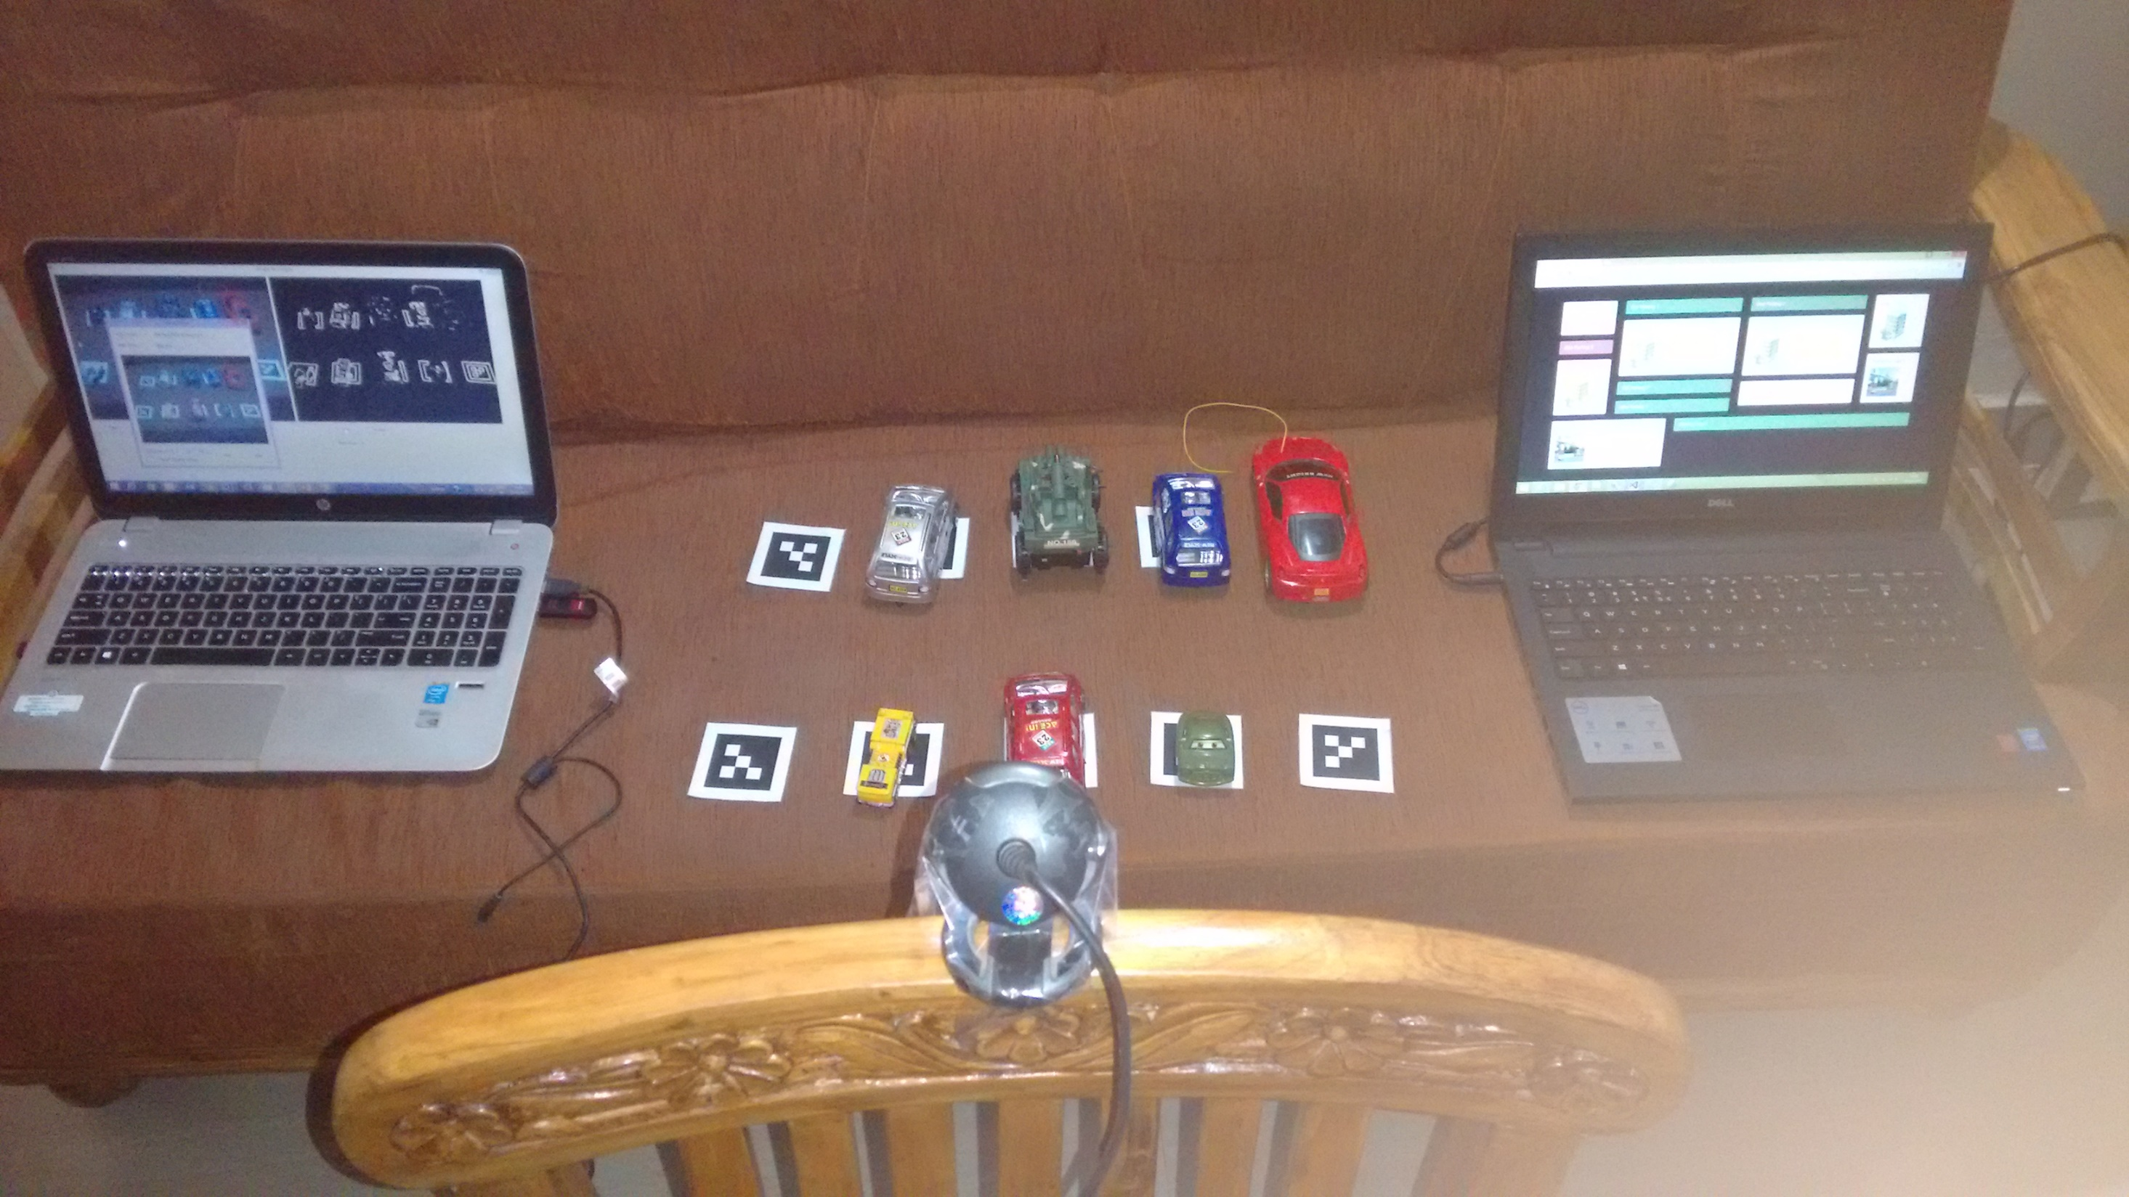
REST Services
Notes:
The webcam continuously monitors the parking area that is connected to the system on the left. The system runs the Video feed and Image Processor. Post processing, services are called that are hosted on the system in the right. This will update the database that is present in the same system. The dashboard in turn fetches data from services and displays the desired information on the screen.

Slide 13
DEMO
Notes:
Let’s have a look at the solution in action.

Slide 14
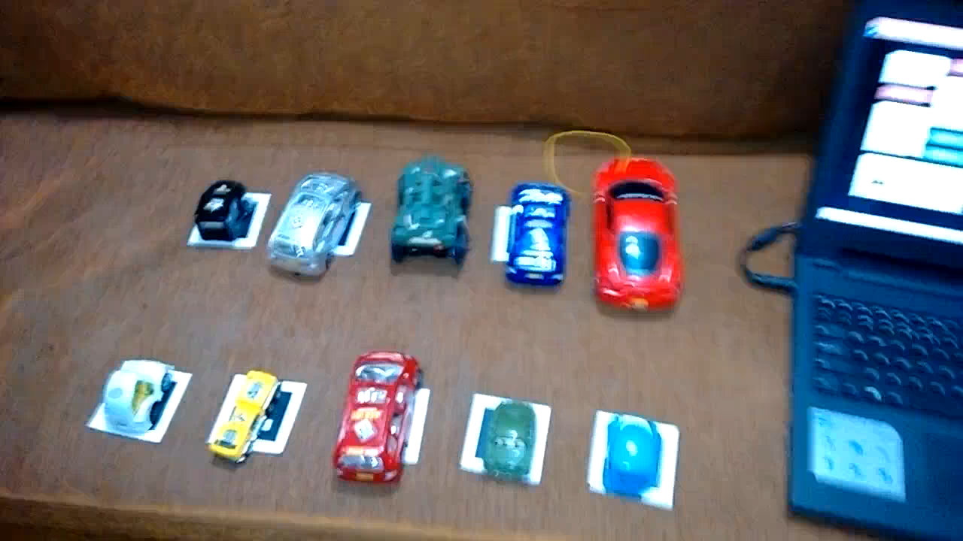
Notes:
We have implemented this for a single parking area. The area on the dashboard is called “Car Parking 1”. The parking area is full now, hence the dashboard shows it as Red. Once a parking slot is made available, the indicator turns green. A commuter parked the vehicle in the free slot, hence the Parking Indicator turned Red again.

Slide 15
Novelty of the Solution
Notes:
The solution is based on Image Processing, hence the hardware required could be reused. For example, if adequate hardware like cameras or networking equipments are not available, then it could be installed. The cost will actually be shared as security cameras will be used by the BCMS group and the networking equipments could be used for making the DC Smarter and Wireless enabled. As the solution uses glyph images, different categories of vehicles could be determined based on usage of distinct glyph images.

Slide 16
Thank You

